Slide 1

8600-342: Developing Own Leadership Capability Using Action Learning
Business Administration

Slide 2

8600-342: Developing Own Leadership Capability Using Action Learning
Week One
Notes:
Management Communication

Slide 3
Assignment Questions
Explain the nature and benefits of action learning (8 marks)
Explain the responsibilities of an individual within an action learning set or group including confidentiality and respect for others (4 marks)
Identify own leadership strengths and limitations based on an assessment of own leadership behaviours and potential (12 marks)
Set personal goals for an extended action learning intervention (8 marks)
Prepare individual action learning plans for involvement in action learning sessions for a minimum of twenty hours (12 marks)

Slide 4
Assignment Questions
Complete planned actions to improve leadership (16 marks)
Monitor and record own participation in action learning sessions (16 marks)
Use feedback from others and own personal reflections to review the effectiveness of action learning undertaken (16 marks)
Identify follow up actions required to continue the leadership journey (8 marks)

Slide 5
Content
Concepts of Action Learning
Revans's Formula
Action Learning Involvement
Benefit of Action Learning
Action Learning Cycle
Roles of Individual and Facilitator in Action Learning
Using Action Learning to develop leadership competencies
Action Learning V.S Leadership
Learning Log

Slide 6
Action learning
Action learning is an educational process whereby people work and learn together by tackling real issues and reflecting on their actions. Learners acquire knowledge through actual actions and practice rather than through traditional instruction.
Action learning is done in conjunction with others, in small groups called action learning sets. It is proposed as particularly suitable for adults, as it enables each person to reflect on and review the action they have taken and the learning points arising. This should then guide future action and improve performance.

Slide 7
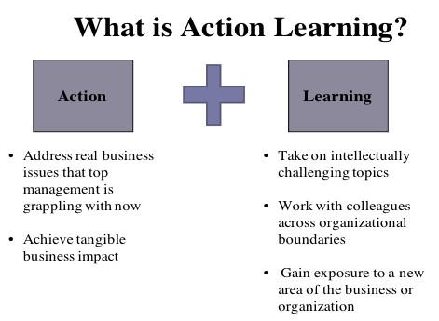

Slide 8
Action learning
In Action Learning groups or 'sets' we meet regularly with others in order to explore solutions to real problems and decide on the action we wish to take. When doing this in the set, the stages include:
1. Describing the problem as we see it
2. Receiving contributions from others in the form of questions
3. Reflecting on our discussion and deciding what action to take
4. Reporting back on what happened when we took action
5. Reflecting on the problem-solving process and how well it is working

Slide 9
Revans's Formula
Professor Reginald Revans is the originator of action learning. he encouraged managers to meet together in small groups, to share their experiences and ask each other questions about what they saw and heard.
The approach increased productivity by over 30% Later, Revans made this more precise in the opening chapter of his book (Revans, 1980) which describes the formula:
L = P + Q
where L is learning, P is programming and Q is questioning to create insight into what people see, hear or feel.

Slide 10
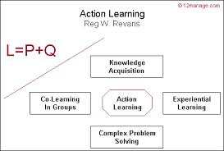

Slide 11
Action Learning Involvement
A group of people (usually 5 or 6) initially with a facilitator
Meeting regularly for an agreed period (eg. 6 occasions)
Sharing real issues, problems or opportunities
Considering professional, personal and organisational goals
Questioning and challenging
Making action points
Reporting back to subsequent meetings
Obtaining feedback
Learning and support others

Slide 12
Action Learning Involvement
The Problem. This provides the focus for the activity. It can be an individual problem or development need as in the Revans’ model or a team problem (project) as in the Inplant approach.
The Client is the person who owns the problem / opportunity. In Revans’ terms this must be someone who knows, who cares, and above all, who can implement a solution if they wish to.
The Action Learning set is where the learning takes place. Members meet to share their experiences, to question, confront, challenge, support and provide the encouragement and stimulus for individuals/sets to carry on.

Slide 13
Action Learning involvement
The facilitator 'facilitates' the learning. This means helping participants to identify their learning needs through questioning, mirroring, challenging and supporting; and for creating the conditions in which these needs are satisfied.
The sponsor is the person, usually a senior manager, responsible for the programme. In Revans’ terms this must be someone who knows, who
cares, and above all, can implement a solution if they wish to. Problems can range from something as simple as developing an individual to launching a new product or re-structuring the organisation.

Slide 14
Benefit of Action Learning
Action Learning benefits the organisation as a whole and its members individually and in teams. Action Learning can:
Assist succession planning by developing a cadre of highly qualified candidates for promotion to executive leadership positions.
Deepen participants' confidence in their leadership and team participation skills.
Enable participants to establish effective, mutually respectful working relationships with co-workers at all organisational levels.

Slide 15
Benefit of Action Learning
Develop competence among individuals and teams in problem-solving and decision-making processes.
Relate action research/action learning theory and methods to organisational challenges.
Enhance participants' capacity to reflect on and learn from their individual and collective experiences.
Develop in participants an awareness of how their implicit assumptions, beliefs, attitudes, preferences, and organisational interests influence their thinking, decisions and actions.
Increase competence in preparing and presenting recommendations concerning urgent organisational issues to executive management.

Slide 16
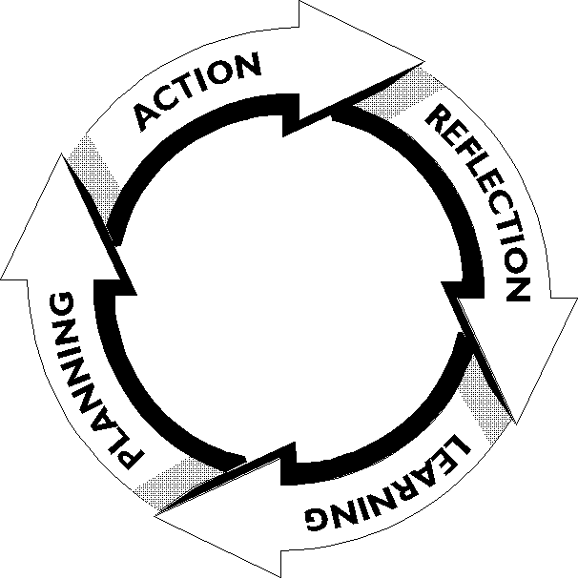
Action Learning Cycle
Action-Learning Cycle (ALC) is a tool to draw learning from action (experience) through an analytical reflection. It helps us to learn from our experience to avoid repeating mistakes or inefficiency of our work and to continuously improve our work.

Slide 17
Action Learning Cycle
Action Review what actually happened (expected and unexpected) How people involved feel about the experience.
Reflection For each action, What worked/went well? What helped? What worked/went not well? What blocked?
Learning What lessons can be learned? What are our conclusions? What new insights, new things discovered?
Planning What to do differently in the future when meeting similar situations?

Slide 18
How Action Learning Works
The set meets for half a day, every 4-6 weeks. If they have met before the process may follow this format. This is a sample guide, not set in stone, and timings are flexible:
i. Start with follow-up from last time. People who have presented before will give action report updates (15 minutes).
ii. Then one person presents a problem, a situation or an opportunity. This may have been agreed beforehand (10 minutes).
iii. Other group members then ask questions. Initially there might be 5 minutes of clarification to make sure the group has understood the issue (25 minutes)

Slide 19
How Action Learning Works
iv. The presenter then has a chance to respond – perhaps fixing an intermediate goal and to outlining next steps. (5 minutes)
v. The facilitator may then step in to review the process, understanding of the issue and confirm actions. (10 minutes)
vi. Then a second person will then present their issue following the same process.
vii. The last 15 minutes is spent with members reflecting on the session and summarising their views of what has happened. Things that went well should be noted and celebrated. They should suggest ideas to improve the process for next time.

Slide 20
Roles of Action Learning Facilitator
The role of Action Learning Facilitator is to manage the smooth running of the set, help the set develop ground rules for working together, develop members questioning, listening and reflection skills and ensure that the process, timings, principles of action learning and ground rules are adhered to.
Ideally the facilitator will not be involved in the questioning process so can focus on managing the process, although there may be times when it is appropriate that they also take on the role of set member to model the skills or to bolster numbers if the set is low in numbers.

Slide 21
Roles of Individual in Action Learning
Listen actively and attentively
Watch for non-verbal cues, such as body language, hesitations
Are attentive to the feelings as well as the words of the presenter
Do not intervene (unless an agreed part of the process)
Ask questions that encourage the presenter to understand the problem for him/herself more clearly

Slide 22
Roles of Individual in Action Learning
Are prepared to probe and challenge the issue holder’s personal interpretations
Are always supportive, encouraging and empathetic
Give feedback appropriately, honestly, and with discretion
Observe the agreed ‘ground rules’ for conduct of set members
Never diagnose, recommend, interpose own agenda or give personal solutions
Never judge or impose own values

Slide 23
Four Critical Leadership Competency
Cognitive skills. Skills and competencies in this cluster include seasoned analytical skills, strategic thinking, creativity, and global perspective.
Execution skills. Skills and competencies in this cluster include customer focus, planning, program management, and focus on results.
Relationship skills. Skills and competencies in this cluster include influencing, engaging and inspiring, managing talent, creating open communication, collaborating, and building relationships.
Self-management skills. Skills and competencies in this cluster include the ability to establish trust, adaptability, impulse control, and curiosity and love of learning.

Slide 24
Learning Styles
Learning style is an individual's natural or habitual pattern of acquiring and processing information in learning situations. A core concept is that individuals differ in how they learn. The idea of individualized learning styles originated in the 1970s, and has greatly influenced education. There are many learning styles, theories about learning styles and names attributed to learning styles.
The following is one such theory of learning styles:
Visual/Verbal
Visual/Non Verbal
Tactile/Kinesthetic
Auditory/Verbal

Slide 25
Using Action Learning to develop leadership competencies
Action learning is an experiential learning process that contributes to leadership development primarily by providing an opportunity to:
(a) practice generating questions that lead to insight, understanding, and innovation,
(b) engage in self-reflection, self-monitoring, and self-directed efforts to learn about oneself and enhance contributions to the team and the problem solving process.
Action Learning participants hone their questioning skills and learn how to generate questions that lead to deep insight, understanding, and innovation.

Slide 26
Action Learning V.S Leadership
Mumford (1995) believes that action learning is so effective because it incorporates the following element necessary for training managers:
Learning for managers should mean learning to take effective action; this is the focus of action learning.
Taking effective action necessarily involves actually taking action, not recommending action or undertaking an analysis of someone else's problem.
The best form of action in order to learn is by means of working on a specific project or an ongoing problem that is significant to the managers themselves.

Slide 27
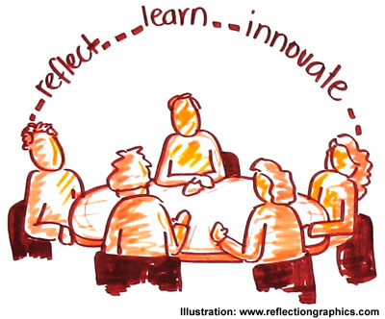
Action Learning V.S Leadership
As ``colleagues in opportunity'', manager scan share problems on which to take action.
In action learning, the people providing help are crucially different than inexperienced professors found in many management training programs.
Rather than being taught through case study or simulation, participants in action learning learn from exposure to real problems and to each other's insights.

Slide 28
Learning Logs
Learning logs are a personalized learning resource. In the learning logs, the participants record their responses to learning challenges set by their teachers. Each log is a unique record of the participant's thinking and learning.
The logs are usually a visually oriented development of earlier established models of learning journals, which can become an integral part of the teaching and learning program and have had a major impact on their drive to develop a more independent learner.
At work, it will also help you to be more effective. Many factors influence our ability to learn. Here for example, is a list of some of the skills we need to develop to become an effective action learner.

Slide 29
Learning Logs
The learning logs help enhance the ability to:
Identify your own learning needs; Plan personal learning; Establish effectiveness criteria for yourself; Measure your effectiveness; Listen to others; Take advantage of learning opportunities; Manage your own learning processes; Take risks and tolerate anxiety; Deal with unwelcome information; Know yourself; Share information with others; Review what has been learnt; Analyze what other successful practitioners do and the capacity to accept help from others.

Slide 30
Getting Starting With Your own Learning Log
The types of things that you might put into your learning log are:
How you reacted to the lecture topic;
What kind of questions popped into your head;
How you related to the information presented and what things you agreed or disagreed with from the material presented; and
The new knowledge that you gained from the material presented.

Slide 31
Getting Starting With Your own Learning Log
Questions to ask yourself as you are writing your learning log:
Am I just restating the material presented in the class and in my readings or am I actually demonstrating analysis, synthesis, interpretation, and insight?
What are the connections I am making, what are the insights, what new idea(s), concept(s) do I now have?
Why is this new knowledge useful?
How is this applicable to my own personal situation?

Slide 32
Getting Starting With Your own Learning Log
How does this relate to my own experience?
How might I do things differently in the future now that I have this new knowledge?
What have I actually learned?
Do I really believe what I am writing?

Slide 33
Class Activity
Making your own learning log

Slide 34
Reference
http://en.wikipedia.org/wiki/Action_learning
http://www.businessdecisions.com.au/faq/what_are_some_benefits_derived_action_learning
http://www.actionlearningsets.com/php/news.php?id=4
http://www.actionlearningassociates.co.uk/resources/nacvs.php
http://www.personal-coaching-information.com/role-of-action-learning-facilitator.html
http://www.camlefa.org/short_articles/Action_Learning_Cycle_Eng.pdf
https://www.dlsweb.rmit.edu.au/toolbox/leadership/toolbox/ls/ls_c08.html
http://www.google.com.sg/search?hl=en&noj=1&biw=1188&bih=538&q=roles+and+behavior+of++action+learning+set&oq=roles+and+behavior+of++action+learning+set&gs_l=serp.3...308185.318788.0.319438.27.19.0.0.0.0.0.0..0.0....0...1c.1.29.serp..27.0.0.SCuw9qEE9LI

Slide 35
Reference
http://www.intrac.org/data/files/resources/733/Action-Learning-Sets-An-INTRAC-guide.pdf
http://www.ala-international.com/actionlearning.html
http://www.google.com.sg/url?sa=t&rct=j&q=how+to+make+a+learning+log&source=web&cd=3&cad=rja&ved=0CDYQFjAC&url=%68%74%74%70%73%3a%2f%2f%77%77%77%2e%6a%79%75%2e%66%69%2f%79%74%6b%2f%6c%61%69%74%6f%6b%73%65%74%2f%70%73%79%6b%6f%6c%6f%67%69%61%2f%65%6e%2f%73%74%75%64%79%69%6e%67%2f%67%65%6e%65%72%61%6c%2d%69%6e%66%6f%72%6d%61%74%69%6f%6e%2d%6f%6e%2d%73%74%75%64%79%69%6e%67%2f%6c%65%61%72%6e%69%6e%67%6c%6f%67&ei=GLlfUvOHM4PJiAfw5oCwCQ&usg=AFQjCNGv83QrcpnkGO6tzK72fbSR3IU8vw&bvm=bv.54176721,d.aGc

